Slide 1
Online Book Store
A reliable place to get book summaries and purchase them
Akshat Gupta
24BCE0607

Slide 2
Problem Statement
Use HTML + CSS + JS to build a portal to browse books and add to cart, with the ability to view them in cart. Convert the same into a React application using the following:
Components (Reusable structure)
Props & PropTypes
State management (useState)
Side effects (useEffect)
Routing

Slide 3
Motivation
As someone who enjoys reading in his free time and prefers physical copies of the same as supposed to e-books, I noticed that sometimes finding certain books in stock or finding them from a reputed seller at a fair price proved to be difficult. So I aimed to create a platform where customers can easily find the books at a fair price.

Slide 4
Existing vs Proposed
There are already several e-commerce platforms (eg: Amazon, Flipkart,etc…) that stock books.
The proposed plan for the website is to be dedicated to books, unlike other platforms. It will also include summaries and ratings for each book

Slide 5
System Architecture or Flow
The user lands on the login page, entering the fields will redirect to the website
All CSS elements controlled using external style.css and all javascript elements on external script.js document.
The header will have logo, search bar and a contact button, while showing the number of books in the cart
Below will be each book with an image of cover page, price and button to add to cart
Clicking on each book will redirect to the individual page of that book

Slide 6
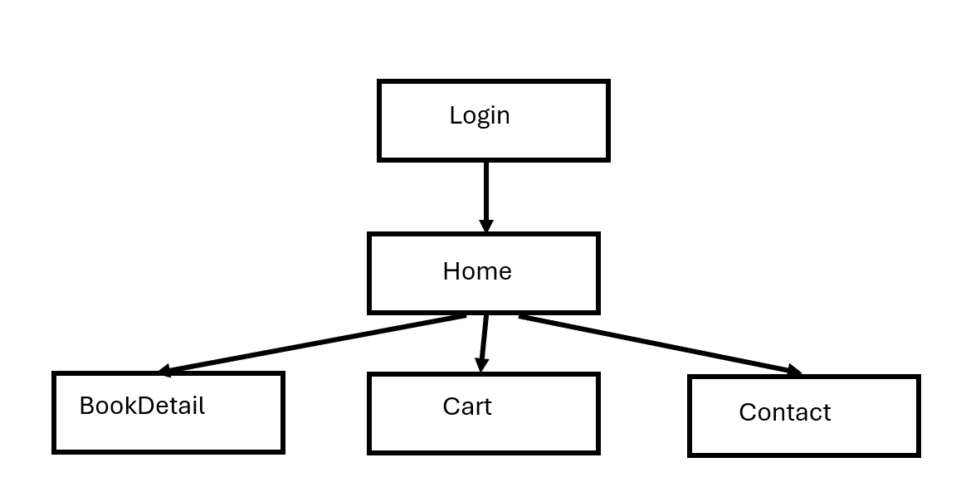
Flow Diagram

Slide 7
HTML Modules ReactJS Modules
Proj.html
Cart.html
Contact.html
Login.html
style.css
script.js
book1.html
book2.html
book3.html
book4.html
book5.html
Navbar.js
Footer.js
Cart.js
Home.js
BookDetail.js
Contact.js
Login.js
style.css
App.js
books.js
index.js

Slide 8
Technologies Used
The entire project was coded using HTML CSS and JS.
HTML tags such as div, img, header, footer and so on used to create the html layout.
Properties related to fonts, background colors and size were mentioned with appropriate tags in stylesheet
In JavaScript the following were used
getElementById to get values from html page
Functions were defined to perform certain tasks, such as search and the grid layout of books
Components, Props & PropTypes, useState, useEffect were used to implement the React Application

Slide 9
OUTPUT SCREENSHOTS

Slide 10
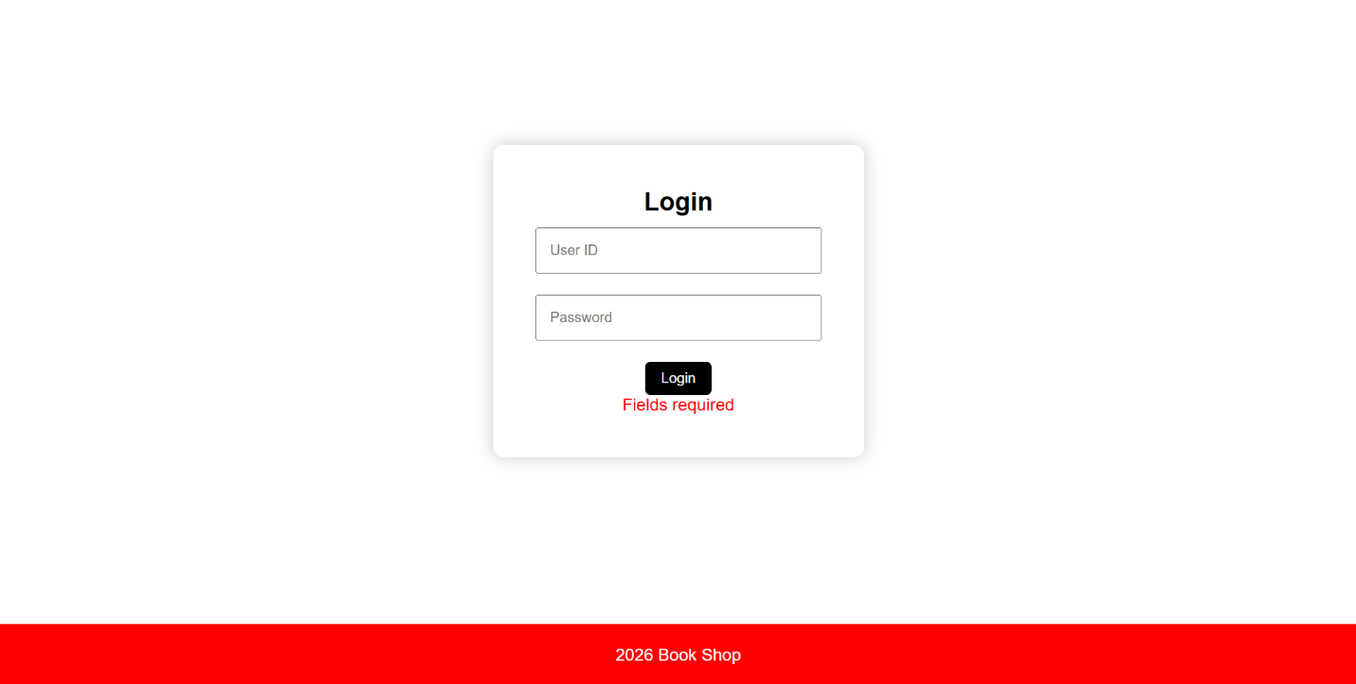

Slide 11
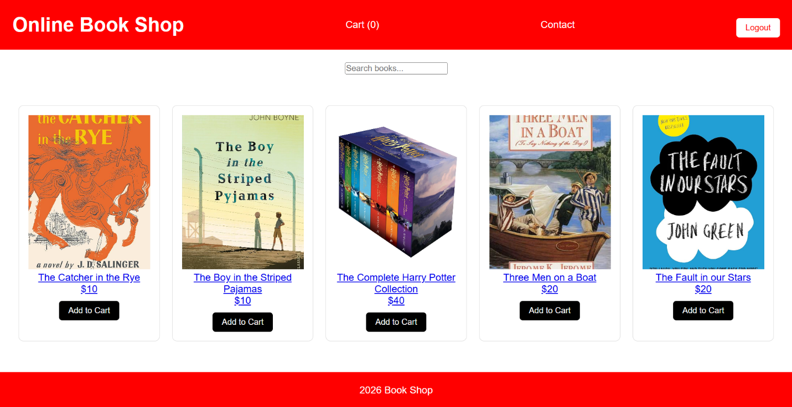

Slide 12
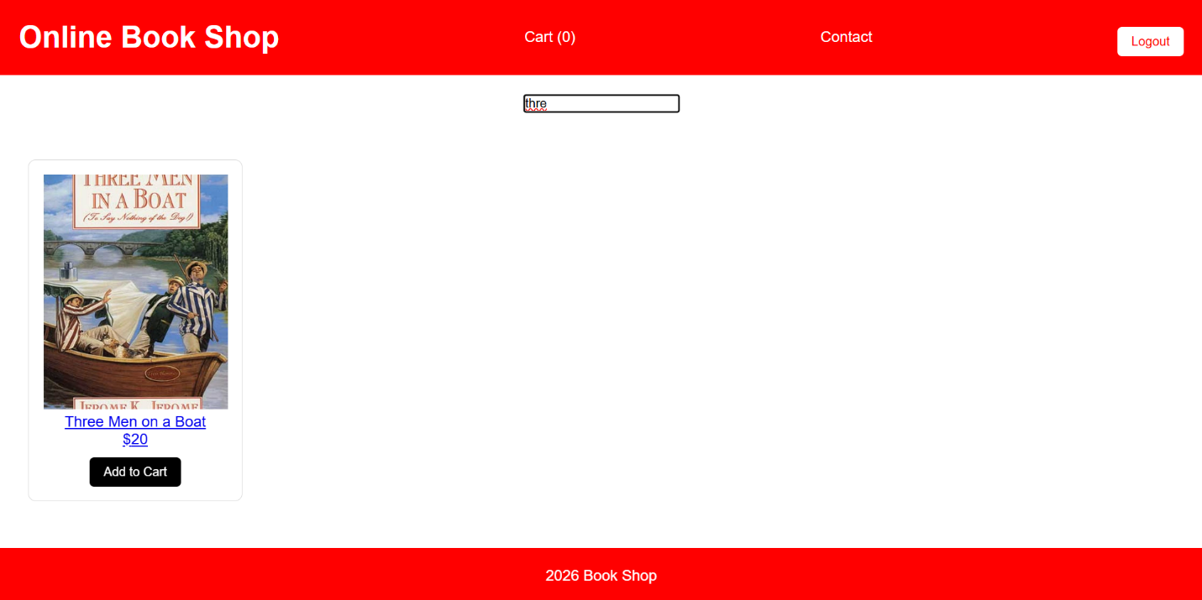

Slide 13
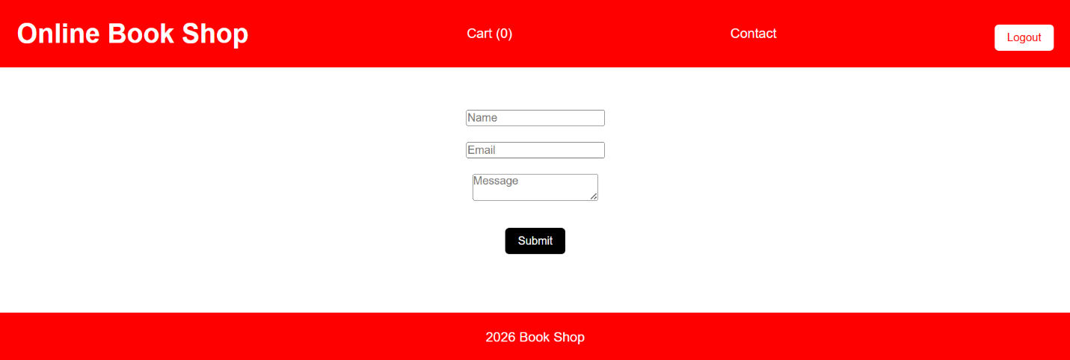

Slide 14
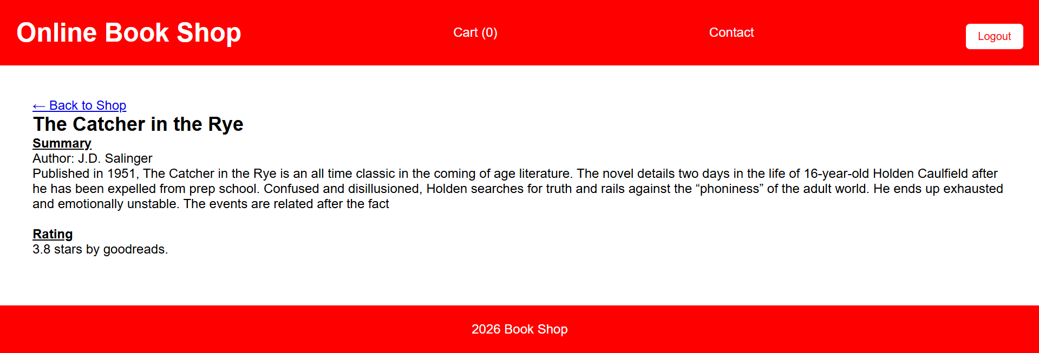

Slide 15
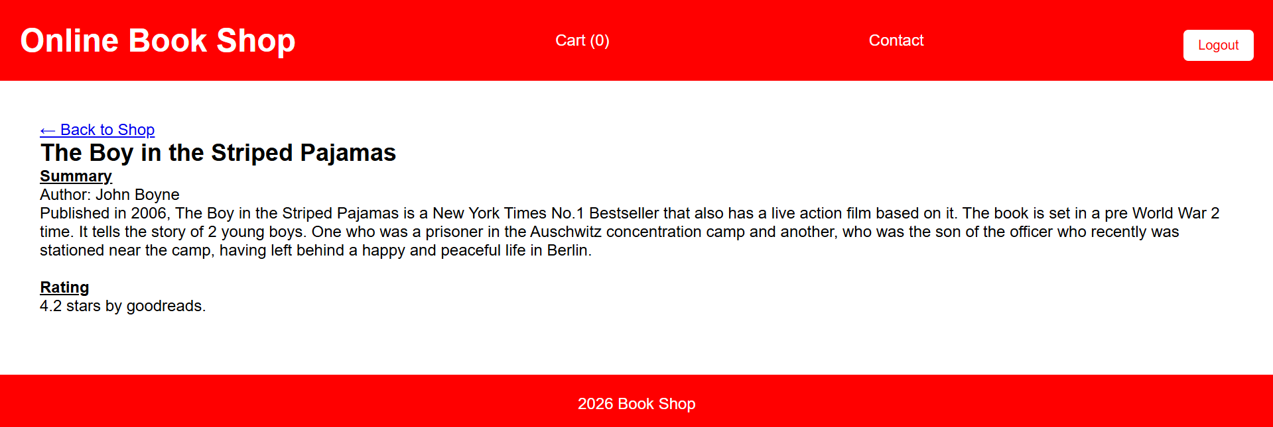

Slide 16
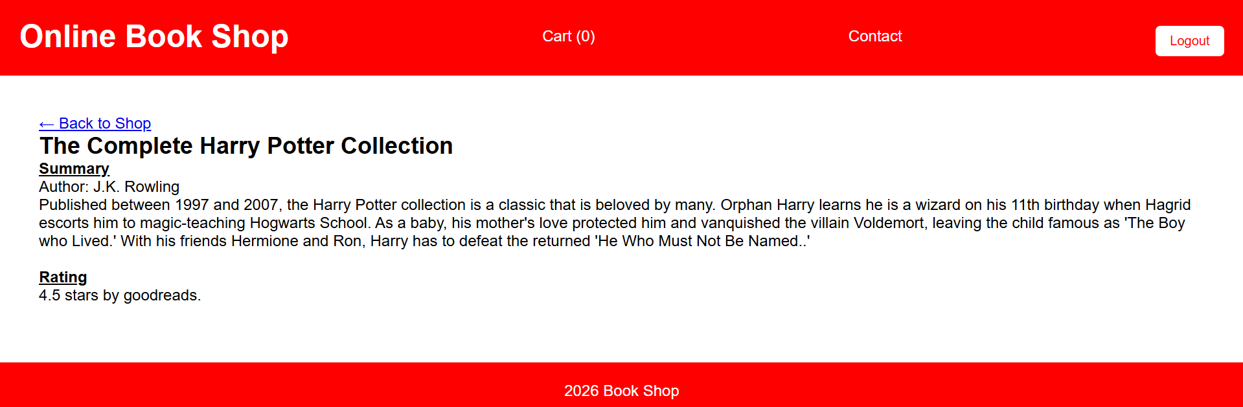
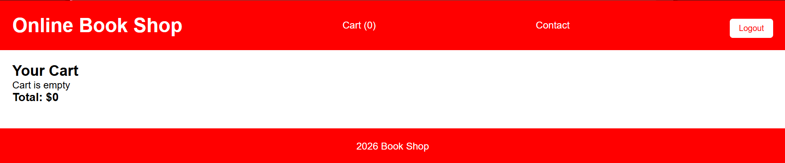

Slide 17
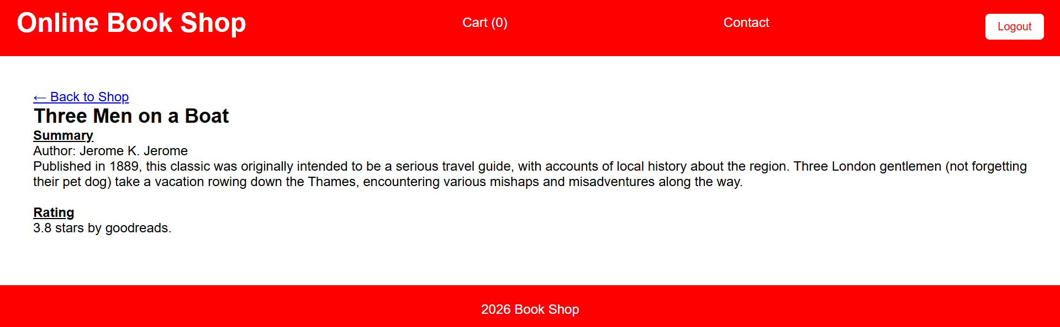

Slide 18
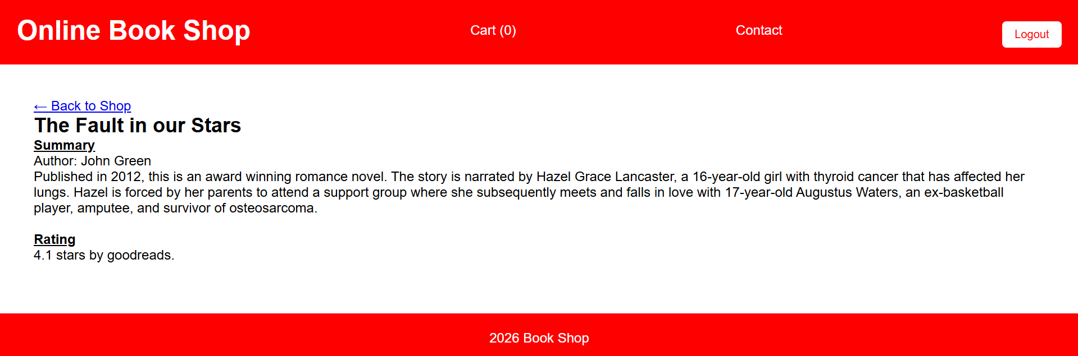

Slide 19
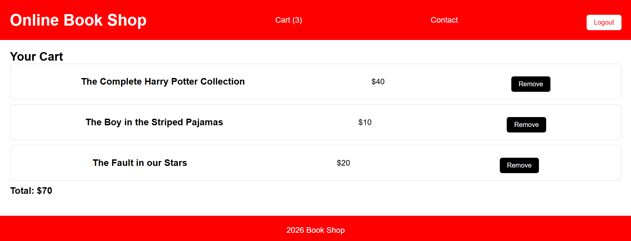

Slide 20
Conclusions
We had set out with a goal to build a website that can be used to browse books, view their details and add them to cart. We have accomplished the same. The desired web pages were initially obtained after coding in HTML and JS, with experimentation in CSS for the appropriate colors and sizes. Later, they were converted to a React application.

